Slide 1
MED-497 Dynamics of immiscible fluids and droplet deformation in a micro-channel under acoustic fields
Group Number:15
Harikrishnan A.-1510110148 Project advisor
Dev Anand-1510110117 Dr. Karthick S
Mohammed Azharudeen-1510110486

Slide 2
Introduction
Acoustophoresis: force acting on micro-particles suspended in fluid medium when subjected to standing acoustic wave
It has been observed that, when a microchannel is acted upon with sufficient acoustics force, irrespective of the initial conditions, the final configuration of the microchannel can be determined and manipulated
Positive mismatch
Negative mismatch

Slide 3
Critical review of literature
Three different initial configurations of the dense (36% iodixanol, white) and less dense (10% iodixanol, black) solution give rise to different
time evolutions.
Jonas T. Karlsen et.al Physical Review Letters (2016)
Separation of a biological sample
comprised of a mixture of Escherichia coli (E. coli) and bovine
red blood cells (B-RBCs)
Gayatri P. Gautam et.al Springer Nature 2018

Slide 4
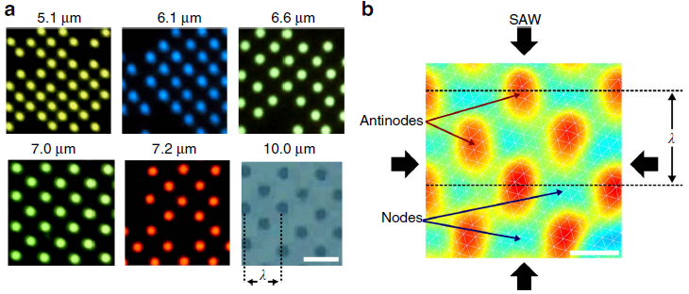
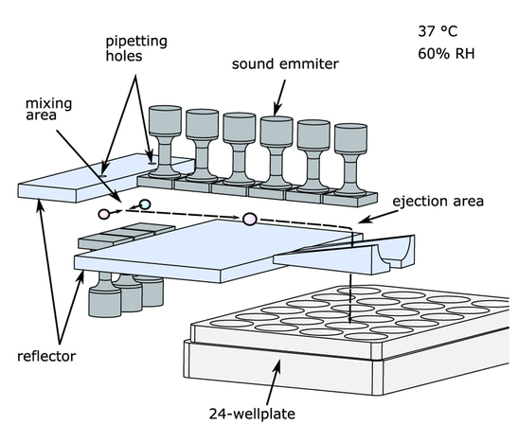
Acoustofluidics: Some clinical and environmental applications
1) Circulating tumour cells isolation from white blood cells
4) Two dimensional patterning of cells using acoustophoresis
J. Collins et.al Nature 2015
5) Container-less manipulation of liquids and solids by enabling mixing procedures
Li et.al 2015 PNAS
2) Milk sample precondition in protein and lipid content quality control.
3) Oil spills in ocean and land.
Thomas Vasileiou et.al Nature 2016

Slide 5
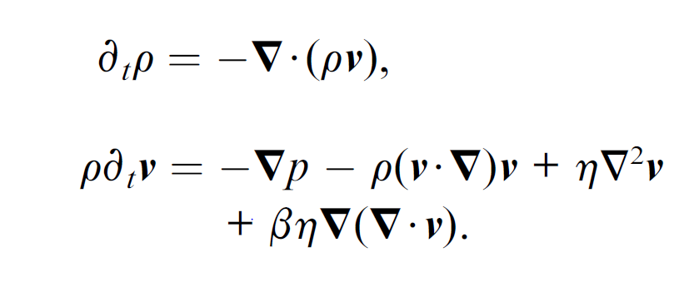
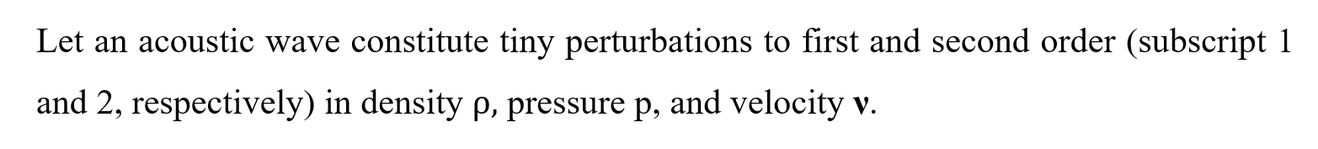
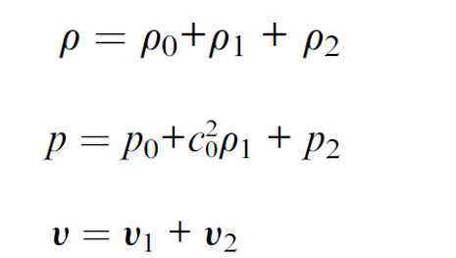
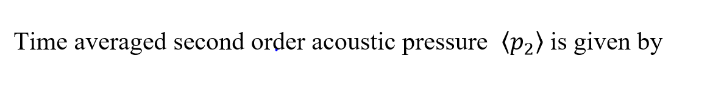
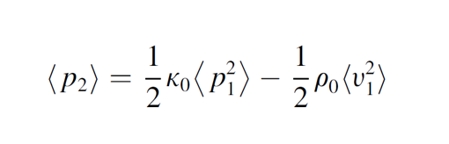
Governing Equations
Navier-Stokes Equation:
Continuity Equation:
Notes:
In the phase–field method, the state of the entire microstructure is represented continuously by a single variable known as the order parameter phipf.
The set of values of the order parameter over the whole microstructure is the phase field.

Slide 6
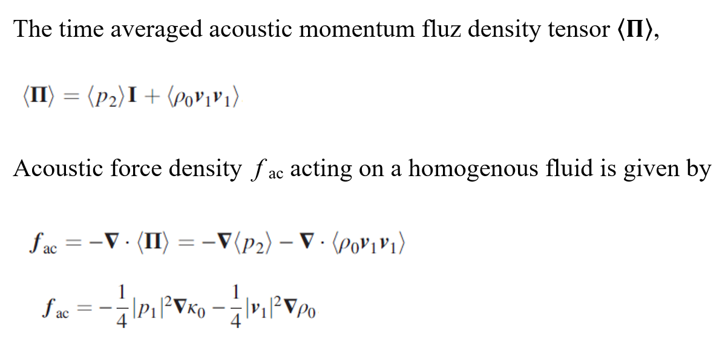
Governing Equations

Slide 7
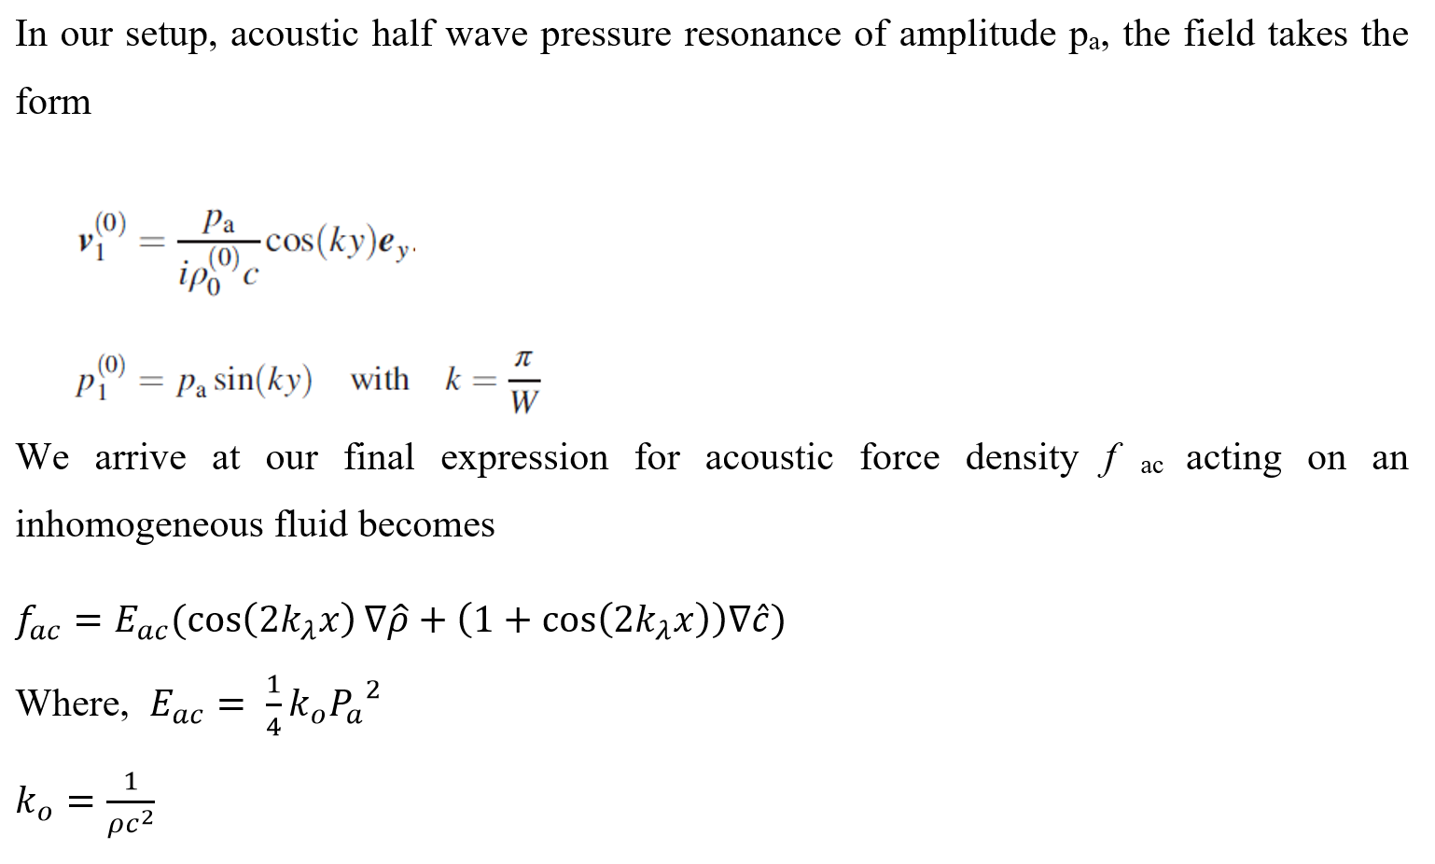
Governing Equations

Slide 8
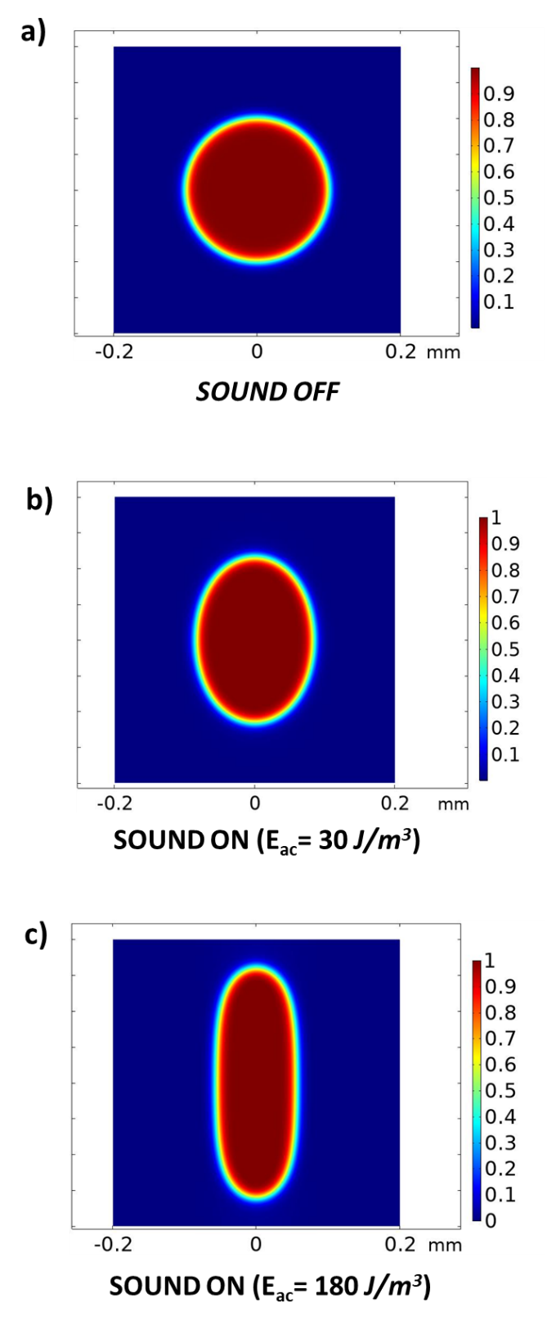
Dynamics of droplets in Acousticfields: A route to microfluidic interfacial tensiometry using acoustophoresis

Slide 9
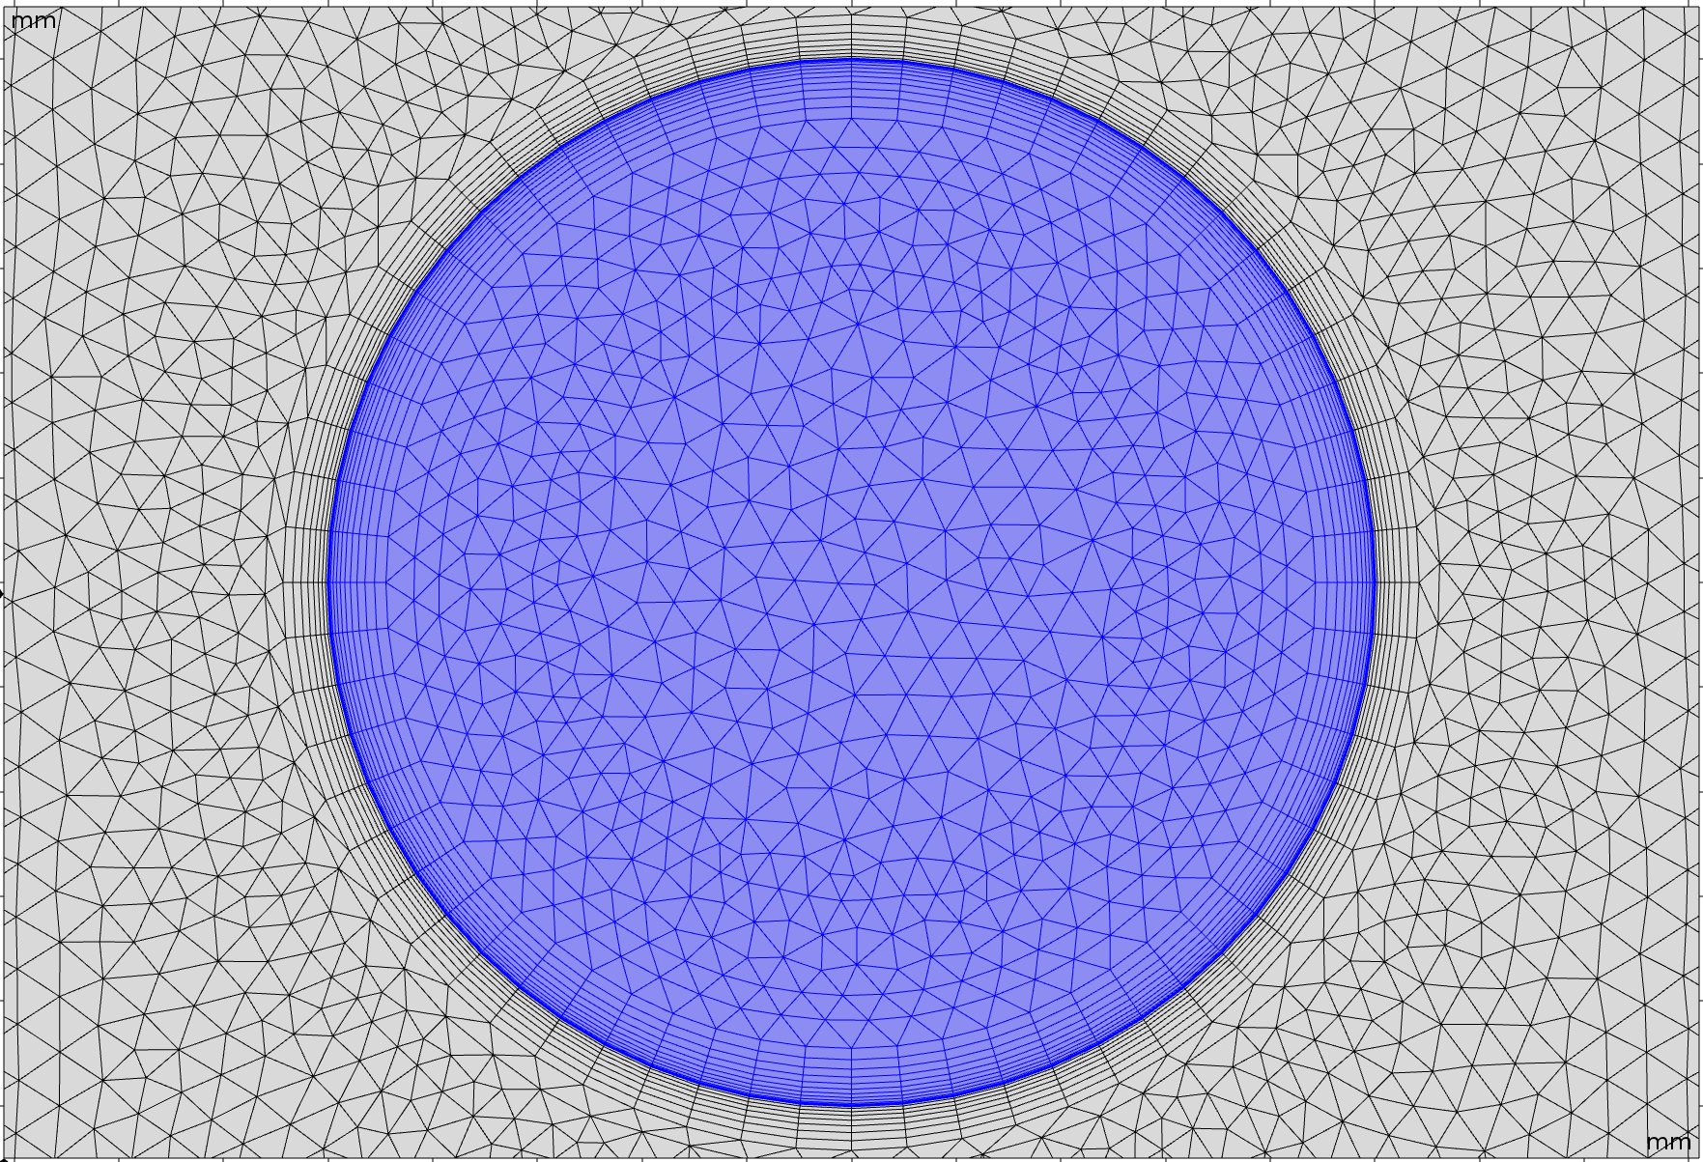
Bubble under Acoustic force.
Meshing
Maximum element size .01 mm
Minimum Element size .00003mm

Slide 11
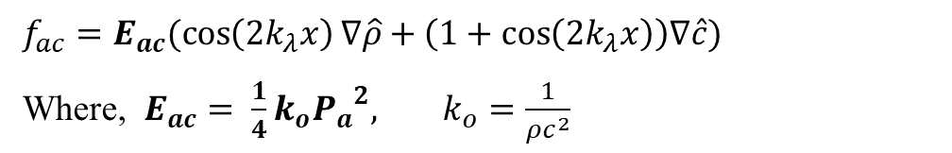
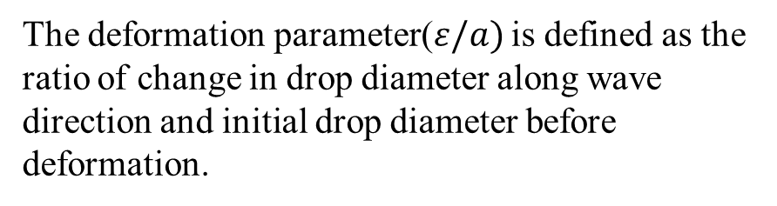
Results
The deformation parameter($ε/a)$ is defined as the ratio of change in drop diameter along wave direction and initial drop diameter before deformation.
$f_{ac}=E_{ac}(\cos\left(2k_{λ}x\right)∇\hat{ρ}+\left(1+\cos\left(2k_{λ}x\right)\right)∇\hat{c})$
Where, $E_{ac}= \frac{1}{4}k_{o}{P_{a}}^{2}, k_{o}=\frac{1}{ρc^{2}}$

Slide 12
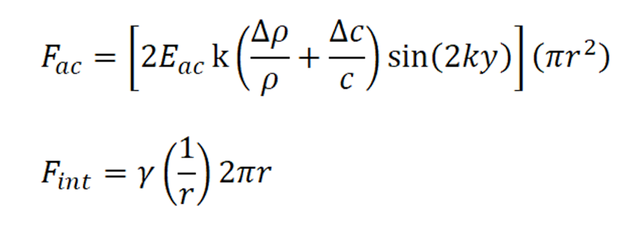
Results
Channel Parameters
Change in radius, ε
Radius strain, ε/a
Channel width, b = 400 microns
Bubble radius, a = 100 microns
Interfacial coefficient, ɣ = .0005 N/m
Density of fluid 1, ρ₁ = 1000 kg/m³
Density of fluid 2, ρ₂ = 880 kg/m³
Wavelength, Λ = 800 microns
Velocity across channel, v = 1400 + 50(1-Φ) m/s
Where Phi, Φ signifies phase field variable.

Slide 13

Dynamics of Immiscible Fluids- Animation
Channel Parameters
Channel width, b = 400 microns
Channel height, a = 200 microns
Interfacial coefficient, ɣ
Density of fluid 1, ρ₁ = 1000 kg/m³
Density of fluid 2, ρ₂ = 900 kg/m³
Wavelength, Λ = 800 microns
Velocity across channel, v = 1400 + 50(1-Φ) m/s
Where Phi, Φ signifies phase field variable.

Slide 14
Results
Channel Parameters
Channel width, b = 400 microns
Channel height, a = 200 microns
Interfacial coefficient, ɣ
Density of fluid 1, ρ₁ = 1000 kg/m³
Density of fluid 2, ρ₂ = 900 kg/m³
Wavelength, Λ = 800 microns
Velocity across channel, v = 1400 + 50(1-Φ) m/s
Where Phi, Φ signifies phase field variable.

Slide 15
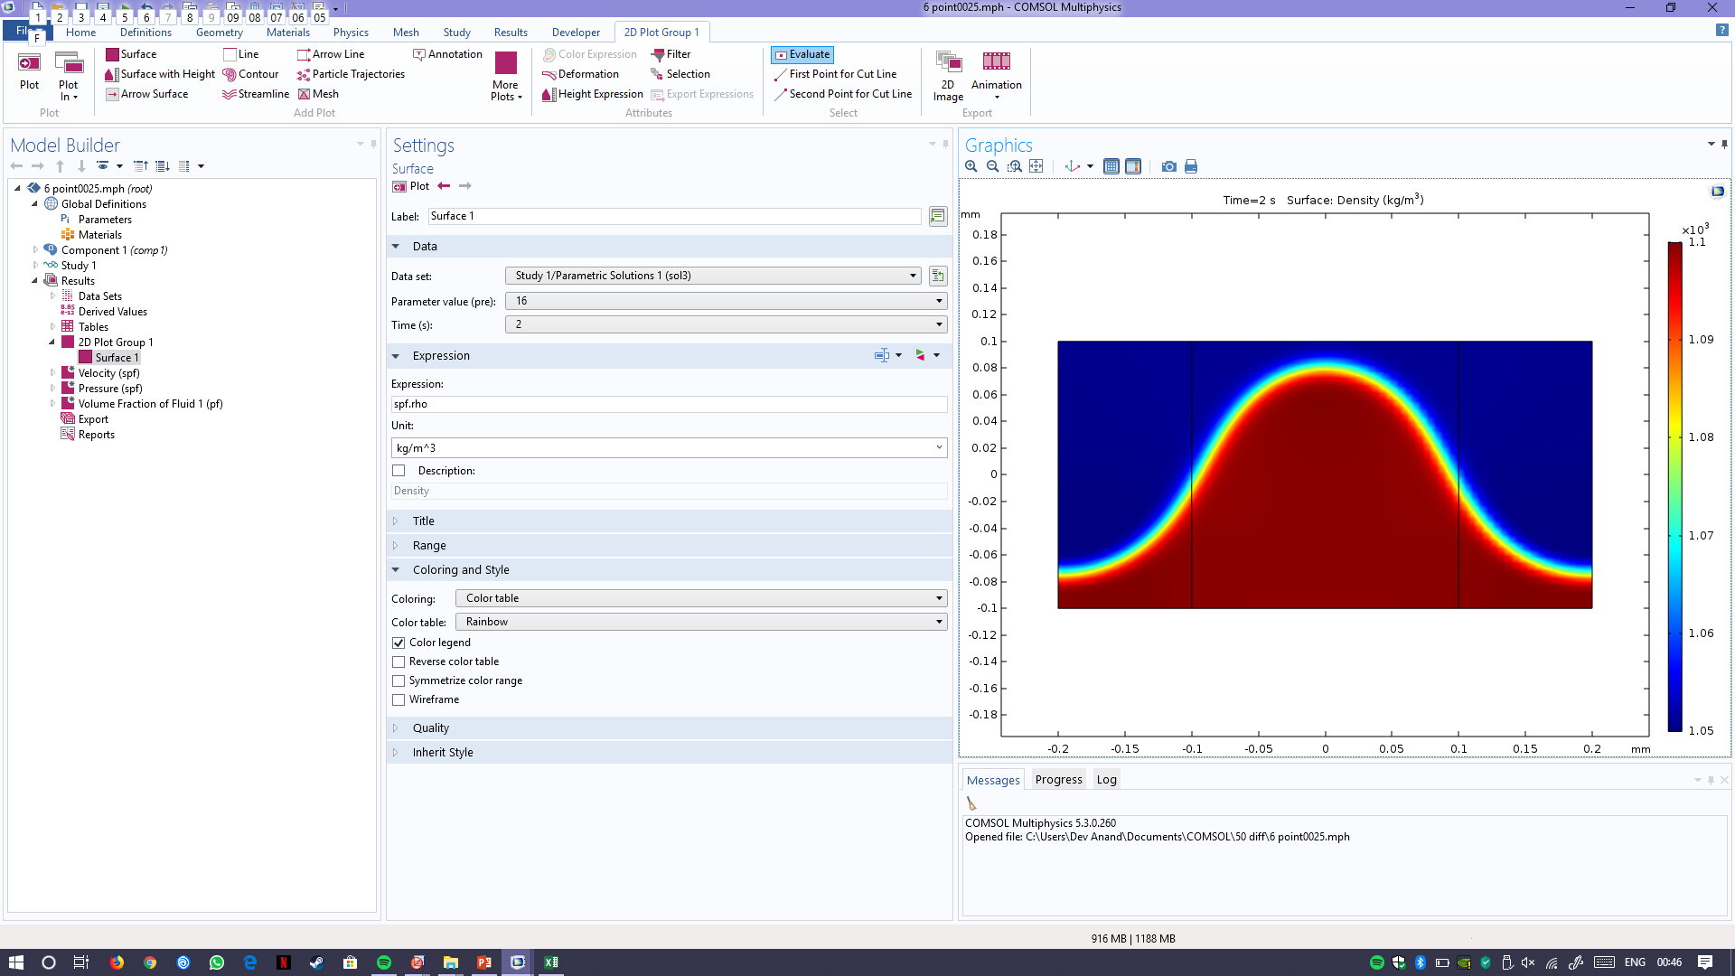
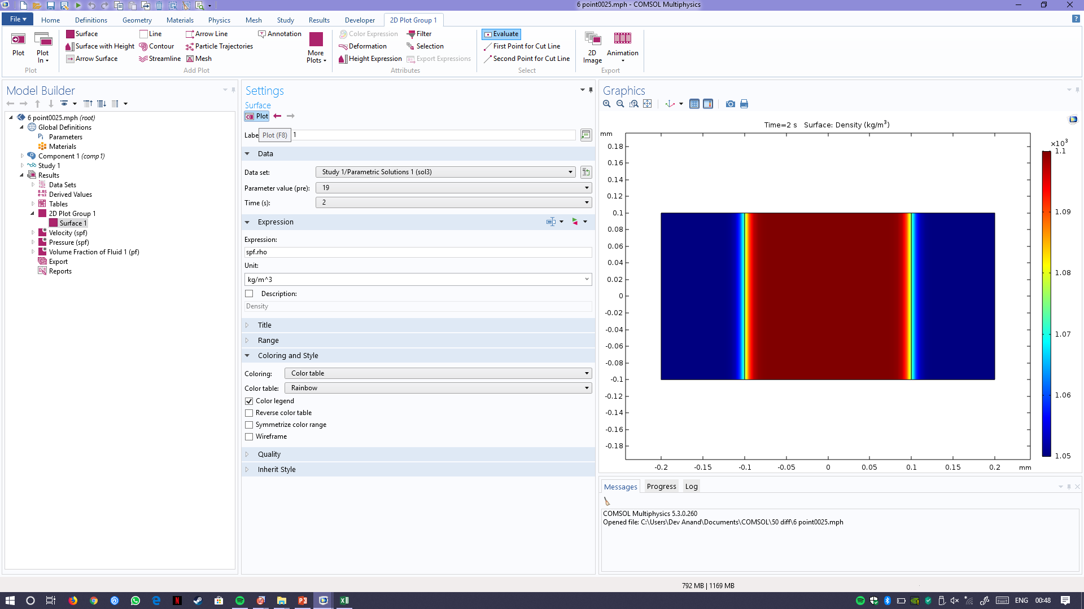
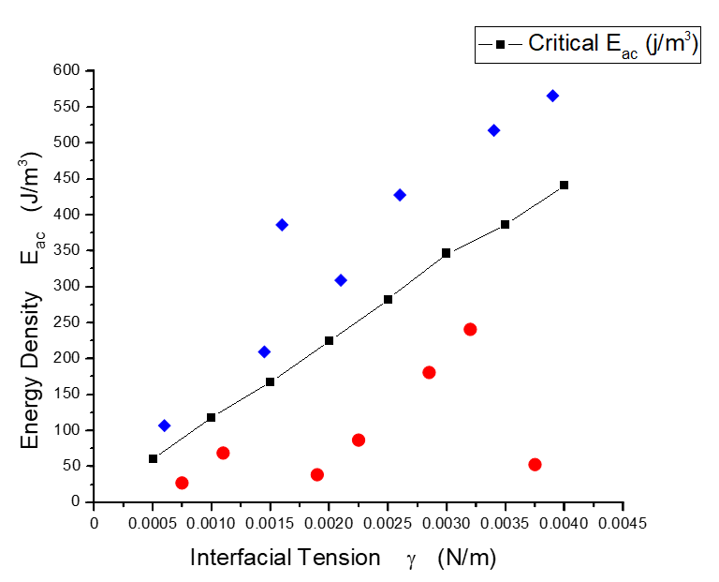
Results
*10⁻³ m
*10⁻³ m
*10⁻³ m
*10⁻³ m

Slide 16
Grid Independency

Slide 17
Conclusion
In this work, by using the expression for acoustic force density f_{ac} for inhomogeneous fluid using time averaged perturbation theory, we have presented theoretical evidence for the relocation of high concentration immiscible fluid in low concentration medium.
The same has been studied and verified for various initial configurations in the COMSOL multi-physics software.
We have found critical E_{ac} values for different interfacial tension various differences in density and sound velocity by simulation.

Slide 18
Conclusion
We also then study the droplet deformation in an immiscible host fluid by simulations and observe the effects of acoustic radiation pressure upon the droplet surface.
Finally, non-dimensionalization of droplet deformation in x axis is done, keeping acoustic force density and force due to interfacial tension in mind.
This paves way route to acoustics based interfacial tensiometry, which is used for measuring interfacial tension between fluids when traditional methods would be difficult to implement.

Slide 19
Deliverables
Submitted abstract for the Twenty Third International Conference on Miniaturized Systems for Chemistry and Life Sciences (µTAS) in Basel, SWITZERLAND
We are currently in the drafting stages of the papers titled “DROPLET DEFORMATION USING SOUND WAVES IN MICROCHANNEL: A ROUTE TO ACOUSTICS BASED INTERFACIAL TENSIOMETRY” and “DYNAMICS OF IMMISCIBLE FLUIDS AND ACOUSTIC STREAMING IN A MICRO-CHANNEL UNDER ACOUSTIC FIELDS”
The target journals are Physics of Fluids and Physical Review Letters(PRL).

